Slide 1
Patented Medicine Prices Review Board
Outreach sessions 2015
Montreal November 5, 2015
Toronto November 6, 2015

Slide 2
Overview
Form 1, original and amendments
Form 2, Block 4 amendments
Form 2, on-line filing for semi-annual reports
Foreign Price Sources
  Lauer Taxe
Incremental Guidelines Update
  Reasonable Relationship Test
  MAPP and Block 5 Canada
PMPRB Strategic Plan

Slide 3
Form 1 - Filing Schedule
FORM 1 Medicine Identification Sheet (electronic Excel format including Product Monograph)
Information | Timing | Patent Act | Regs
Identity of the drug product, patentee and patent(s) | Earliest of: Seven (7) days after the date of the first NOC issued Seven (7) days after date of first sale in Canada | 80(1)(a) 80(2)a) | 3(1) 3(2) 3(3)
Updating information on identity of the drug product/patentee | Within thirty (30) days after any modification of information |  | 3(4)

Slide 4
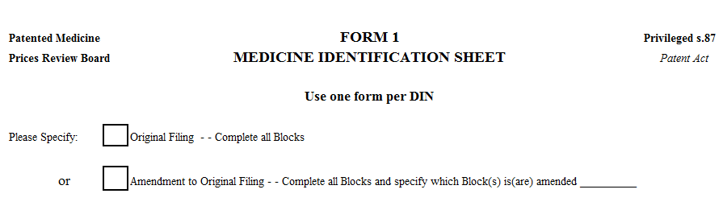
Form 1
Select only one box: either an Original filing or an Amendment to Original Filing.
Indicate which Blocks are being amended.

Slide 5
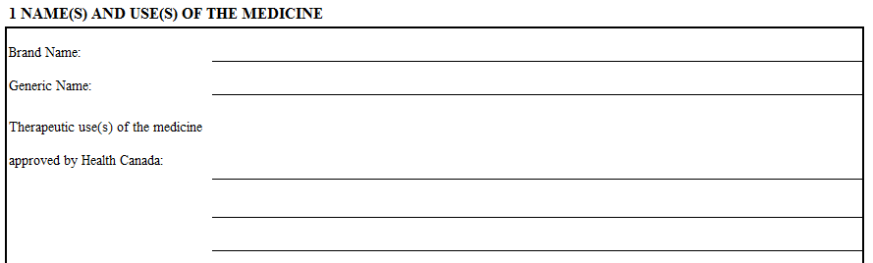
Form 1 – Block 1
Do not add any lines to the therapeutic use area. If the description is longer than the lines provided, continue typing in the lines after it no longer appears on the Form itself.

Slide 6
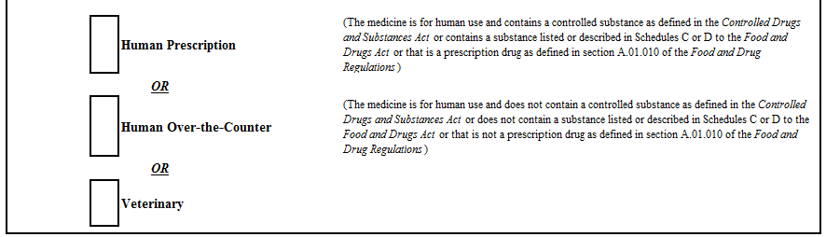
Form 1 – Block 1
Select ONE of Human Prescription, Human Over the Counter or Veterinary.

Slide 7
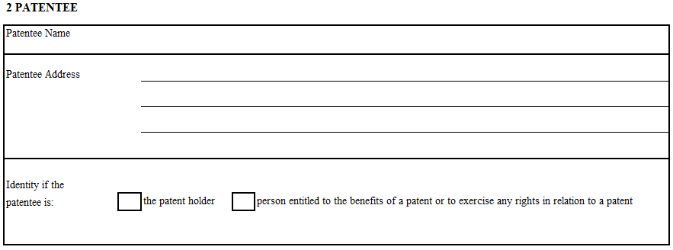
Form 1 – Block 2
Where more than one patent pertains, and the patentee is the patent holder for one patent and the person entitled to the benefits of a patent for another patent, please only select patent holder. Only one box may be checked.

Slide 8
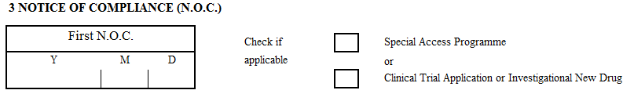
Form 1 – Block 3
If a Notice of Compliance has not yet been issued, leave this box blank and check off the appropriate box.

Slide 9
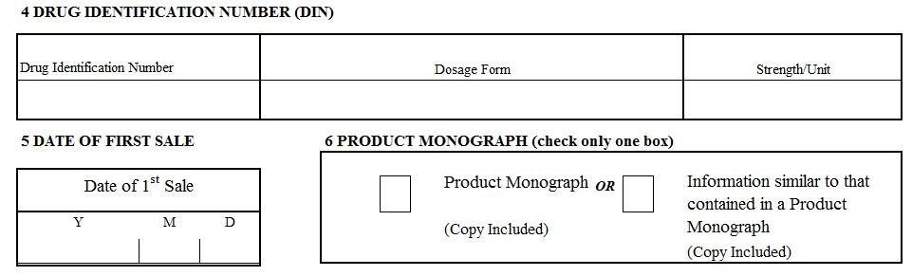
Form 1 – Blocks 4, 5 & 6
If the product does not have a DIN, fill in Dosage Form and Strength/Unit of Block 4 and leave “Drug Identification Number” blank.
If the product is not yet sold, leave Block 5 blank.
Block 6 - Check off either product monograph or information similar and attach when submitting Form 1.

Slide 10
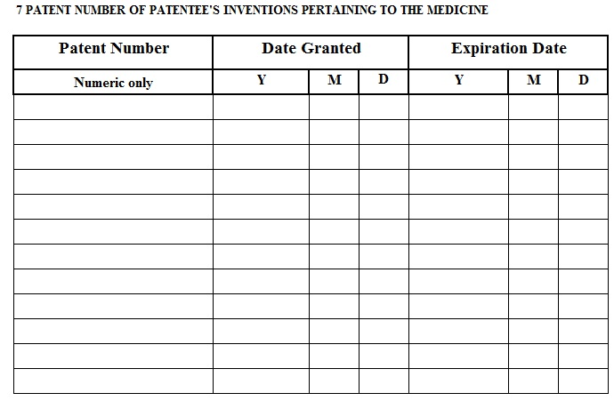
Form 1 – Block 7
The patent number must be numeric only. No commas.
If the patent has been granted, include the date. If it has not yet been granted, leave that box blank. An expiration date must be included.

Slide 11
Patent (Patent Act section 45)
If application filed on or after October 1, 1989
  Duration = 20 years after filing date
If application filed before October 1, 1989
  Duration = 17 years from date on which patent was issued

Slide 12
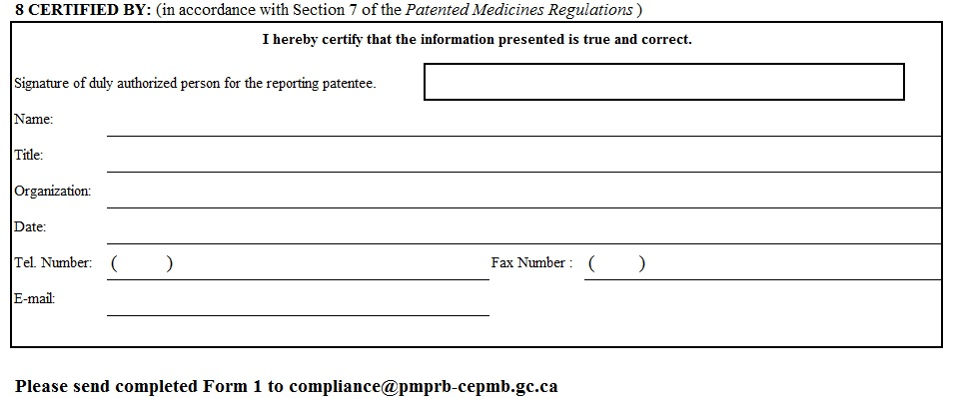
Form 1 – Block 8
Submitted in Excel format with electronic signature OR
Submitted as a pdf copy of the signed Form 1 along with the unsigned version of the Form 1 in Excel format

Slide 13
Form 1 – Tips to avoid most common errors
Do not comment directly on the Form 1 template: include a separate document (Word or email)
Use the most recent version of the Form 1 template which is available from the PMPRB website (avoid retrieving the template through a Google search)
Do not change template
Form 1 must be submitted in Excel format. A signed pdf version may be submitted in addition to the Excel
Send Form 1 to
  compliance@pmprb-cepmb.gc.ca

Slide 14
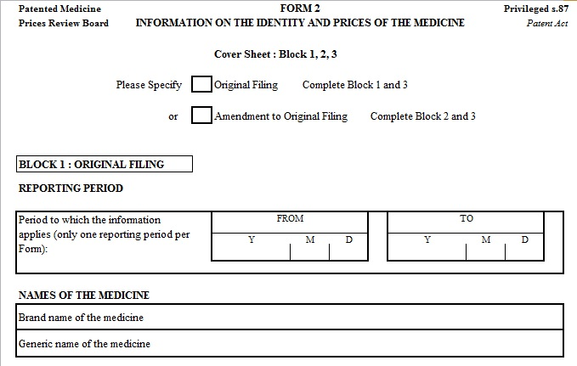
Form 2 - Amendments
Select the box: Amendment to Original Filing

Slide 15
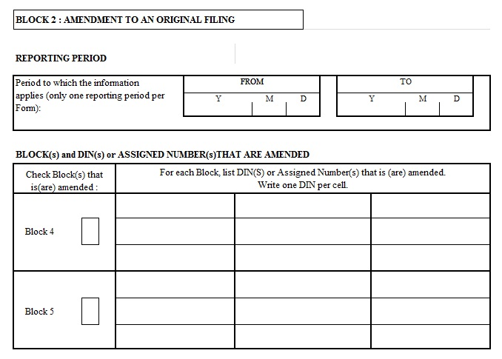
Form 2 - Amendments – Block 2
Provide the start date and end date of the period being amended
Only one semi-annual reporting period per Form 2 amendment
Check the Block(s) being amended and the relevant DINs

Slide 16
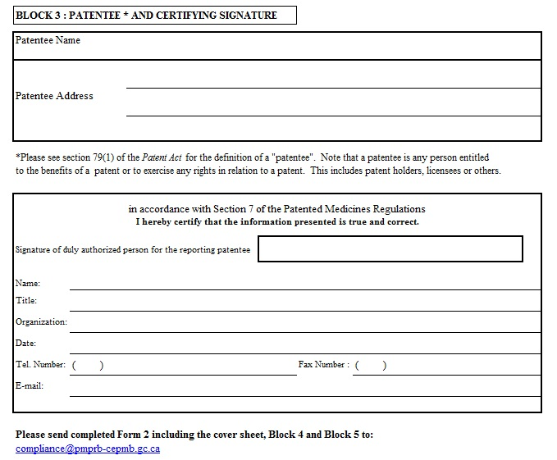
Form 2 - Amendments – Block 3
Patentee in Block 3 section must be the same as the Form 1 for medicine
Form 2 must be submitted in Excel with electronic signature for Block 3 OR as a pdf copy of the signed Block 3 along with the unsigned version in Excel format

Slide 17
Form 2 - Amendments - Block 4
File your data using the Excel Block 4 template
Use the most recent version of the Block 4 template which is available from the PMPRB website (avoid retrieving the template through a Google search)
Do not modify the format of the Block 4 template
Do not comment directly on the Block 4 template: include a separate document (Word or email)
Send amendment to
  compliance@pmprb-cepmb.gc.ca

Slide 18
Form 2 – Amendments – Block 4 - Tips
Reconcile original data with data revisions
Explain every change in data revisions and support with evidence
File consistently over time
Board Staff will inform the patentee:
  whether amendments are accepted
  changes to the compliance status of the affected drug product as a result of the amendments

Slide 19
Example - Data Corrections
Original submission:
250 packages of 100 units per package for net revenues of $50,000.00
Patentee realizes that pack size should be 10 units
Amendment:
If patentee files amendment as follows, it is in line with explanation
  250 packages of 10 units per package for net revenues of $50,000.00
However, if patentee files as follows, additional explanation required. Expectation is that if only issue is incorrect package size, the only change should be to package size.
  250 packages of 10 units per package for net revenue of $250,000.00

Slide 20
Form 2 – Online filing tool
Currently only for semi-annual filings
Patentees file directly online using template received 45 days prior to regulatory deadline (click on link in Patentee Section of PMPRB website)
Patentee can request password reset where it is forgotten
Error reports are sent back to the patentee with a brief description of the problem to be resolved
New error to be added for July to December 2015
  If no block 4 there should not be block 5 for drug product

Slide 21
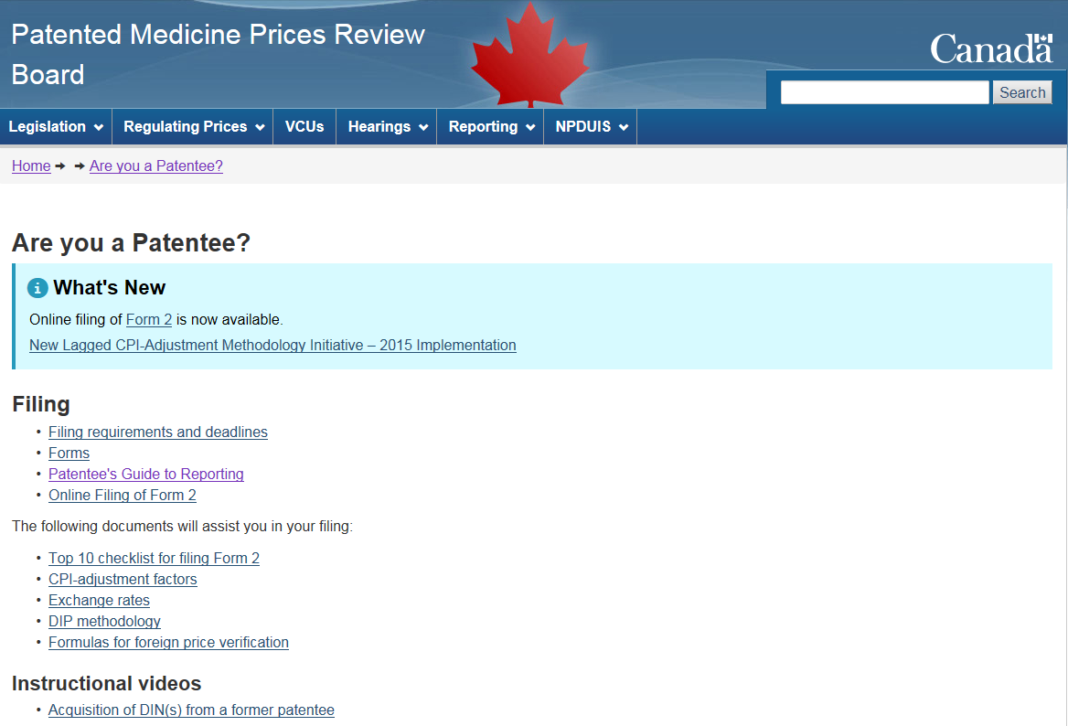
Where to find everything you need….
Website: http://www.pmprb-cepmb.gc.ca/

Slide 22
If you still have questions
For assistance on completion of the reporting forms, please send an email to:
compliance@pmprb-cepmb.gc.ca

Slide 23
Lauer Taxe - Overview
Usual and Customary international ex-factory pricing sources
Implementation of Lauer-Taxe
WEBAPO and the prices available
How to calculate the Block 5 price to file
Additional information: hospital and pharmacy prices

Slide 24
Lauer-Taxe
At the November 2014 Outreach sessions (and again in the January 2015 NEWSletter) Board Staff announced a transition to Lauer-Taxe as the Board’s Usual and Customary (“U&C”) international pricing source for Germany.
The rationale given at the time was that the Lauer-Taxe is a “better and more reliable, publicly available, and comprehensive” source of German ex-factory prices than Rote Liste (the previous U&C source).
Stakeholders were informed that: “PMPRB foreign price verification for Germany will be based on ex-factory prices published in the Lauer-Taxe, net of all publicly available rebates.”

Slide 25
Lauer-Taxe WEBAPO
Several patentees have since contacted Board Staff requesting detailed guidance on how to appropriately include Lauer-Taxe price data in their Block 5 data submissions
In this brief presentation, we will introduce you to the Lauer-Taxe WEBAPO tool, which publishes detailed information on German ex-factory prices and the publicly available rebates necessary to appropriately submit Lauer-Taxe data.

Slide 26
Regulatory Data Calculations
There are two key values necessary for patentee price filings:
1. Abgabepreis pharmazeutischer Unternehmer / Herstellerabgabepreis (“APU”), the wholesaler ex-factory price
2. Pflichtrabatt des pharmazeutischen Unternehmers (“PDPU”), the statutory rebates which are deducted from the APU
Mandatory reimbursement (130a SGB V abs. 1)
Vaccine rebate (130a SGB V abs. 2)
Off-patent rebate (130a SGB V abs. 3b)
Price moratorium rebate (130a SGB V abs. 3a)
German statutory rebates can be found in Book 5 “Statutory Health Insurance” of the German Social Code (“SGB V”).

Slide 27
Rebates A
Mandatory Reimbursement (130a SGB V abs. 1)
Health insurance funds must be given a 7% rebate from the APU (excluding the 19% Value Added Tax, “VAT”) by pharmacies and wholesalers, and the pharmaceutical companies themselves are then obligated to reimburse this 7% to pharmacies and wholesalers.
Vaccine rebate (130a SGB V abs. 2)
Health insurance funds also receive rebates for vaccines. The average price per unit is calculated based on the selling price of the company in the four member states of the European Union with the largest Gross National Income. This methodology results in a percent discount that varies between 0.4% and 18.6%, depending on the drug in question.

Slide 28
Rebates B
Price moratorium rebate (130a SGB V abs. 3a)
Any increase in the APU greater than the APU price on August 1, 2009 must be fully compensated to health insurance funds until December 31, 2017.
Off-patent rebate (130a SGB V abs. 3b)
If a drug product has the same active ingredient as an off-patent product, or a drug product which that had the same active ingredient and was available in Germany on April 1, 2006, pharmaceutical companies must offer a rebate to insurance funds of 10% of the APP.

Slide 29
Calculating the Block 5 Germany Price
The math is straightforward: subtract the PDPU rebates from the APU Price to determine the Form 2, Block 5 price to be filed for a given package size.
Example:
APU: €30.84
PDPU: €4.93
€30.84 – €4.93= €25.91 ← price to be filed in Form 2, Block 5
Note: there is no need to calculate or remove the VAT from these calculations, the VAT is already removed from the APU by Lauer-Taxe.

Slide 30
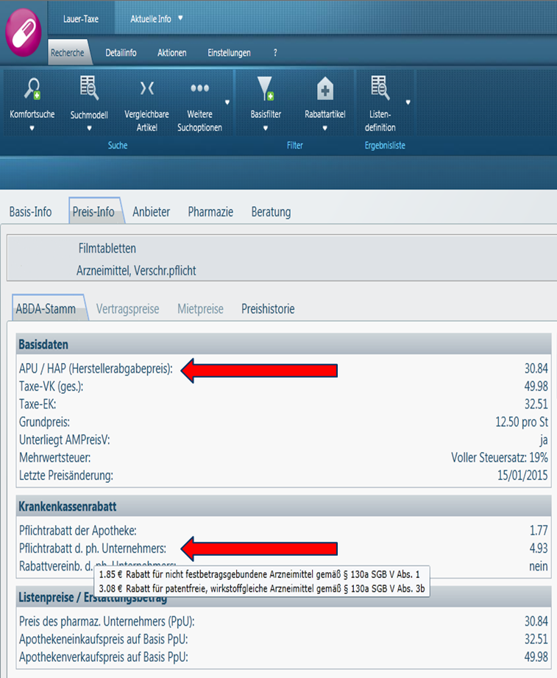
What this looks like in practice
Both key values can be found in the “Preis-Info” section of Lauer-Taxe’s WEBAPO.
As you can see in the example, WEBAPO also decomposes the PDPU into its component statutory rebates for further detail. It is not necessary to submit the decomposition, the aggregated PDPU is sufficient.

Slide 31
Impact
Board Staff have studied the impact of this approach to using the Lauer-Taxe for all drugs for which the German price affected a price ceiling in 2014.
On average, this would result in a price reduction from Germany of 11.3% relative to 2014 patentee filings, but would only result in one additional investigation.
In the event that the switch to the Lauer-Taxe, and the application of this methodology, results in an investigation that would not have occurred if the Rote Liste was used, patentees will be notified, and given an additional year’s grace period to bring their NATP into compliance with the new ceiling.
As an aside: the ex-factory price in Germany using IMS Midas would result in a price reduction of 12.19% over Rote Liste.

Slide 32
Summary
Using the Lauer-Taxe as the U&C source to calculate the German Form 2, Block 5 price provides the best ‘apples-to-apples’ comparison available for German and Canadian ex-factory prices.
These rebates are not confidential (i.e. not PLAs or MEAs), they are statutory rebates created through the German AMNOG legislative process. As such their deduction is equivalent to standing PMPRB practice of removing regulated mark-ups and VATs from Block 5 prices.

Slide 33
Incremental Guidelines Update - Overview
Proposed Changes
Reasonable Relationship Test Amendment
  Rationale
  Impact Assessment
List Price Relative to Maximum Potential Price Verification
  Rationale
  Impact Assessment
Notice and Comment

Slide 34
Changes for 2016
On an on-going basis, Board Staff review the Guidelines for the purpose of recommending incremental changes that ensure that the Guidelines:
Are responsive to relevant developments; and
Protect Canadian consumers from the potential abuse of market power.
In this regards, Board Staff plan to seek comment on two incremental changes to the following sections of the Guidelines
Reasonable Relationship Test (Schedule 4)
Review of Prices of New Patented Drug Products at Introduction (Section C.11)

Slide 35
Reasonable Relationship (RR) Test
Proposal: When applying the Reasonable Relationship Test to line extensions (i.e. when a new drug and comparable drug product are the same active substance and owned by the same patentee), that non-excessive National Average Transaction Price (NATP) be used to establish the MAPP.
If the new drug and the comparable drug product are owned by different patentees, then the current rules would apply: lowest of the six publicly available sources establish the MAPP (AQPP, IMS Health, McKesson, ODB, PPS Pharma, RAMQ).

Slide 36
Rationale
Current practice has in some instances created a situation in which a non-excessive comparable drug product may have an N-ATP greater than the lowest of the six public sources.
The approach to use the six publicly available sources was implemented in 2010 to provide predictability and fairness.
The proposal to use the N-ATP when possible and the six publicly available sources otherwise for establishing the MAPP with the RR test would meet these objectives as well.
As such, in response to a review of regulatory data to date and in line with PMPRB priorities, Board Staff believe it is appropriate to use the non-excessive N-ATP for price comparison in the RR test
Notes:
Same dosage regimen
Same chemical entity
Same indication or use
Same or comparable dosage form

Slide 37
Impact analysis
The immediate impact would be negligible: in 2014 the RR Test was applied to 46 new DINs.
Only 7 of these cases would be affected by this change (comparator is owned by the same patentee AND the NATP of the comparator was greater than the lowest publicly available price).
The difference between the NATP of the comparator and the lowest publicly available price was less than 2% for all of these cases.
The primary benefit of this change is improved efficiency and continued protection of consumer interest.

Slide 38
Questions

Slide 39
List Price Relative to MAPP Verification
Proposal: An addition be made to section C11 “Review of Prices of New Patented Drug Products at Introduction” that requires patentees to ensure that domestic list prices for new drugs are below the MAPP.
In addition to the current approach, for new drugs, Board Staff will compare the publicly available ex-factory price of the six sources identified in the Guidelines (AQPP, IMS Health, McKesson, ODB, PPS Pharma, RAMQ) and require patentees to ensure that they are below the MAPP.

Slide 40
Rationale
To date, Board Staff have not systematically evaluated whether domestic list prices exceed the MAPP. Historically, this was because the difference between these prices and the N-ATP at introduction was negligible.
However, the ratio of domestic Block 5 prices to N-ATP has been increasing in recent years, from 1.059 to 1.079 since 2010.
Unlike the average transaction price which is calculated across various customer classes and regions, the list price is an actual price paid
Ex-factory gate list prices represent a sizeable share of the Canadian market, including many private payers (35%), the uninsured and directly by insured consumers through their co-pays (23%), and is the base price for most pCPA negotiations. This makes the list price central to the PMPRB’s consumer protection mandate.

Slide 41
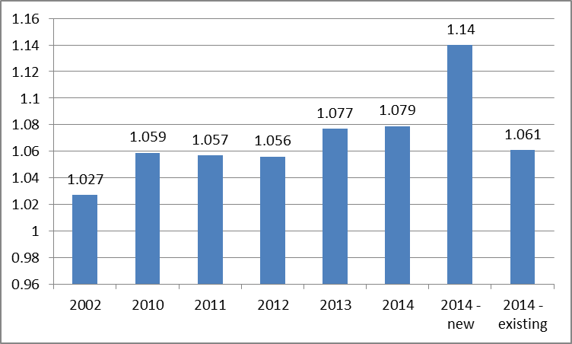
Rationale
Block 5 : Block 4 Price Ratios
Median foreign-to-Cdn price ratios

Slide 42
Impact Assessment
The immediate impact of this change would be minor. Of the 101 patented drugs that entered the market in 2014, only 25 submitted Block 5 prices greater than the MAPP (by an average of 5.7%).
Only 9 of these drugs had Block 5 prices more than 5% greater than the MAPP, and of those 9 all but 1 were already under Investigation.
It is the view of Board Staff that this was always the intent, but an explicit Guideline change would elevate awareness of the Board’s commitment to adapt to market developments in order to protect Canadian consumers and make an important and relevant contribution to sustainable drug costs for all payers.

Slide 43
Notice and Comment
A Notice and Comment is anticipated to go out in early November with a 30 day period for Comment. A side-by-side treatment of the exact changes to the Guidelines will be available at www.pmprb-cepmb.gc.ca.
Interested parties are invited to submit comments to Guillaume Couillard at guillaume.couillard@pmprb-cepmb.gc.ca.
Written submissions should be sent to:
Box L40
333 Laurier Avenue West, Suite 1400
Ottawa, Ontario K1P 1C1

Slide 44
Questions and Comments?

