Slide 1
Patented Medicine Prices Review Board
Outreach Sessions 2014
Montreal - December 2, 2014
Toronto - December 3, 2014

Slide 2
PMPRB Participants
Tanya Potashnik, Director, Policy and Economic Analysis Branch
Jeff Biggs, Manager, Policy Development
Joel Weber, Senior Regulatory Officer
John Cook, Senior Regulatory Officer (Montreal)
Kirk Stanley, Senior Regulatory Officer (Toronto)

Slide 3
Overview
Best practices related to the filing of Form 3s
Block 5 and Board Staff sources for Verification of International Prices
Online filing tool update
Update on the regulatory amendment regarding filing
Interpretation Policy

Slide 4
Patented Medicine Prices Review Board
Form 3
Jeff Biggs, Manager, Policy Development

Slide 5
Objectives
To provide information on how to submit Form 3.
More about Form 3 filing requirements and deadlines can be found in the Patentee’s Guide to Reporting (http://www.pmprb-cepmb.gc.ca/view.asp?ccid=523#816).

Slide 6
Do I have to fill out a Form 3?
If you are a patentee selling patented drugs in Canada, then you must fill out Form 3.
If you are no longer a patentee but were a patentee during part or all of the year that Form 3 covers, you are still required to submit Form 3 information in respect of that calendar year.

Slide 7
Why should I fill out Form 3?
Patent Act 88(1):
“A patentee of an invention pertaining to a medicine shall, as required by and in accordance with the regulations, or as the Board may, by order, require, provide the Board with such information and documents as the regulations or the order may specify respecting:
The identity of the licensees in Canada of the patentee;
The revenue of the patentee, and details of the source of the revenue, whether direct or indirect, from sales of medicine in Canada; and
The expenditures made by the patentee in Canada on research and development relating to medicine.”

Slide 8
What counts as R&D?
Patented Medicines Regulations, Section 6:
“For the purposes of subsection 88(1) of the Act, the expression “research and development” means those activities for which expenditures qualify, or would qualify if the expenditures were made by a taxpayer in Canada, for an investment tax credit in respect of scientific research and experimental development [SR&ED] under the Income Tax Act as that Act read on December 1, 1987.”

Slide 9
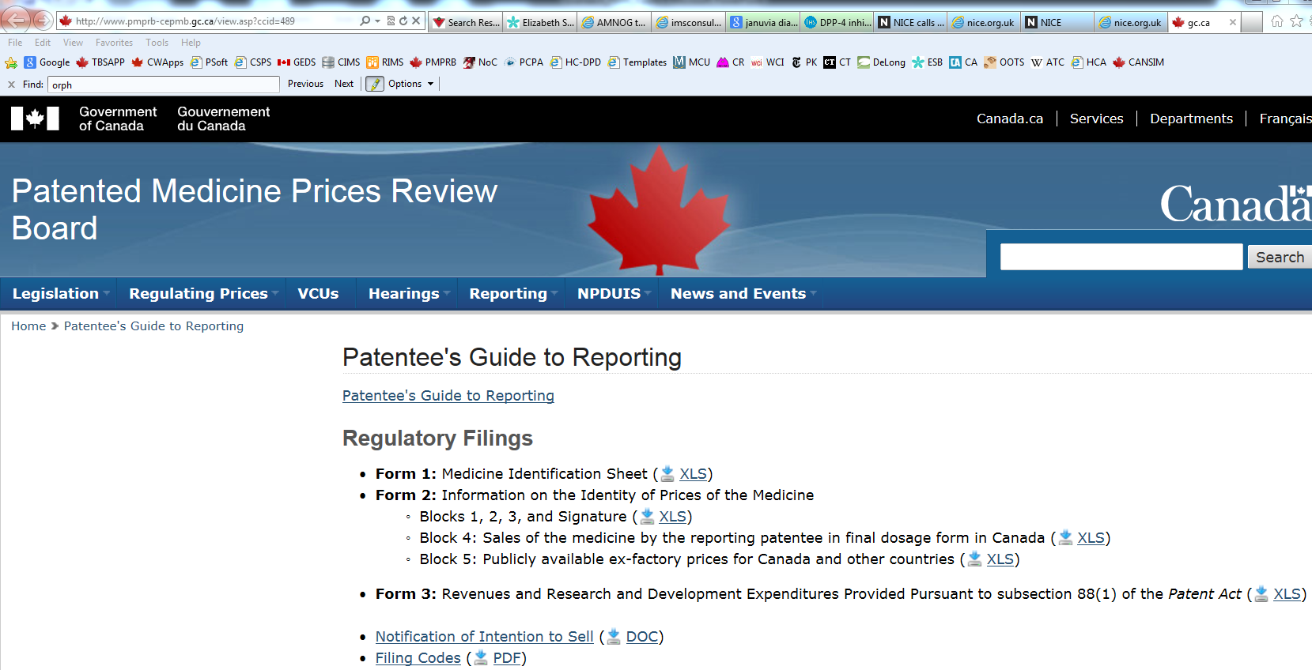
Where do I find Form 3?
Patentee’s Guide to Reporting: http://www.pmprb-cepmb.gc.ca/view.asp?ccid=489

Slide 10
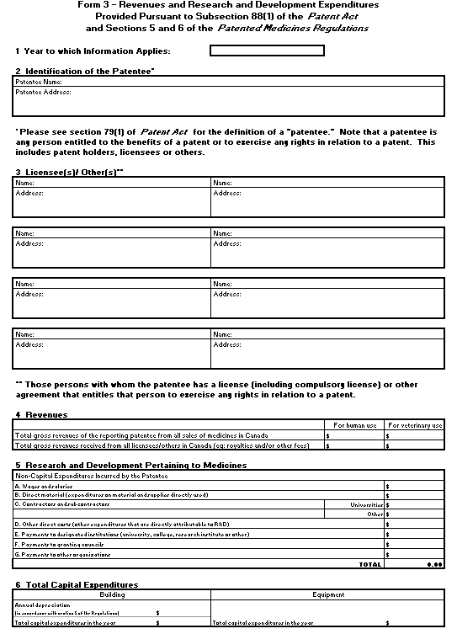
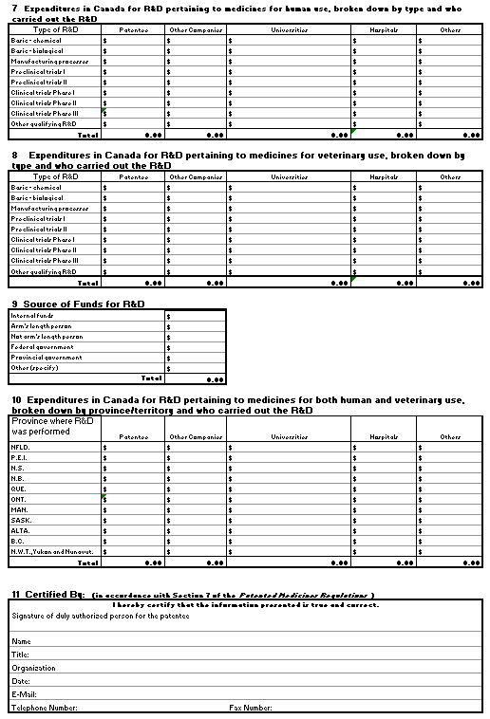
What does Form 3 look like?

Slide 11
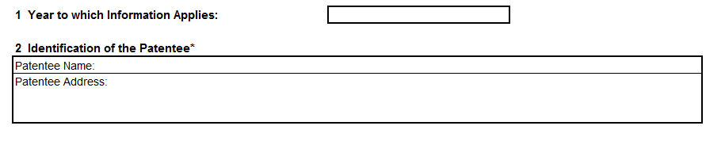
How do I fill it in?
Block 1 – Year to which Information Applies
  Enter the calendar year to which the information applies.
Block 2 – Identification of the Patentee
  State the name and address of the company (patentee) completing the form.

Slide 12
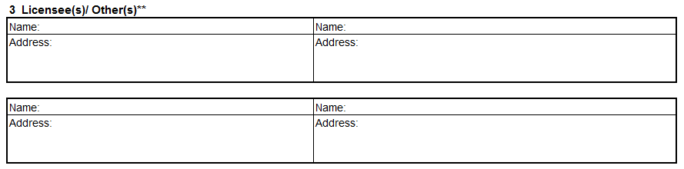
How do I fill it in? (cont’d)
Block 3 – Licensee(s)/Other(s)
  Provide the names and addresses of all licensees with whom the patentee has a license (including compulsory licenses) or other agreement that entitles that person to exercise any rights in relation to a patent.

Slide 13

How do I fill it in? (cont’d)
Block 4 – Revenues
  Report the total gross revenues of the patentee from ALL Sales of Medicines (including both patented AND non-patented medicines) whether sold by prescription or OTC, and whether for human or veterinary use, in Canada.
  Report the total revenues (net of taxes) received (including royalties and license fees) from ALL licensees/others listed in Block 3 associated with sales in Canada.

Slide 14
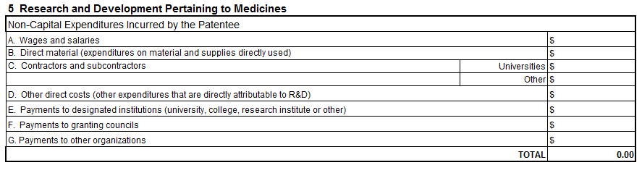
How do I fill it in? (cont’d)
Block 5 – R&D Pertaining to Medicines
  The following CANNOT be included as non-capital expenditures in Block 5 under ANY circumstances:
Capital expenditures | Legal or accounting expenses
Depreciation expenses | Convention expenses
Entertainment expenses | Membership fees or dues
Advertising/selling expenses | Fines or penalties
Expenditures made to acquire-rights-in/arising-out-of R&D (e.g.patent or registration fees)

Slide 15
How do I fill it in? (cont’d)
Wages and salaries – only include wages and salaries (+benefits) paid to employees who work in research.
Direct material – all costs are to be the net laid-down price after deducting trade discounts, etc.
Contractors and sub-contractors – only covers contractors hired to carry out SR&ED (The Scientific Research and Experimental Development ) on the patentee’s behalf.
Other direct costs – incremental general admin and/or factory overhead costs incurred SOLELY through SR&ED.
Payments to designated institutions – payments to an approved university (etc) carrying out SR&ED on your behalf.
Payments to granting councils – approved include: NSERC and Canadian Institutes for Health Research.
Payments to other orgs – payments for SR&ED related to your class of business and not included in “E” or “F”.

Slide 16
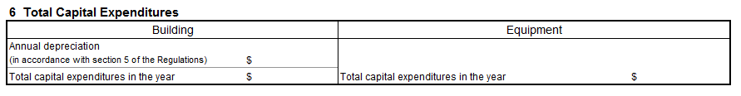
How do I fill it in? (cont’d)
Block 6 – Total Capital Expenditures
  Annual Depreciation (Buildings) – report only for buildings used for SR&ED in Canada. Annual depreciation should be calculated at the rate of 4% of the qualifying capital cost per year over a maximum of 25 years. Depreciation is applied beginning with the year in which the building was purchased or acquired.
  Total Capital Expenditures (Buildings) – report only for buildings used for SR&ED in Canada. Do not include capital expenditures made on land.
  Equipment – expenditures must be made in Canada. When an asset is imported and used for SR&ED in Canada, the expenditure is considered to be made in Canada. Normal accrual accounting principles apply.

Slide 17
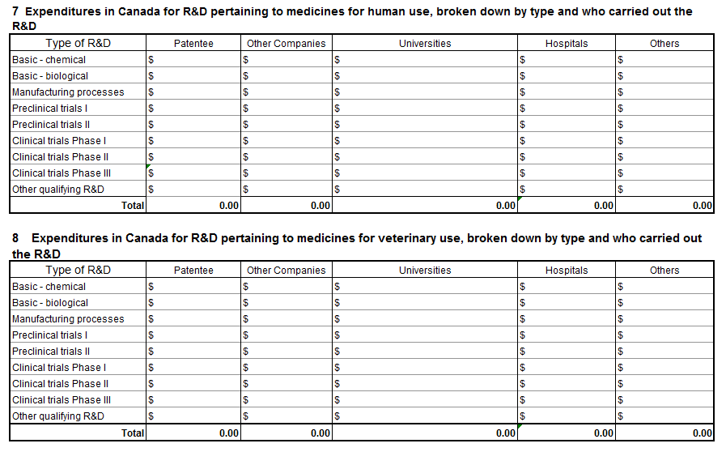
How do I fill it in? (cont’d)

Slide 18
How do I fill it in? (cont’d)
Preclinical and Clinical Trials: generally preclinical trials involve animal testing while clinical trials involve human subjects, though these often overlap. Some drug evaluations may not follow the phases described here:
Preclinical Trials I
Acute toxicity
Detailed pharmacological studies
Specifications or analysis of active substance
Stability of active substance
Specifications of inactive substances
Preclinical Trials II
Pharmacokinetics
Chronic toxicity
Reproduction toxicological studies
Mutagenicity and carcinogenicity studies
Synthesis of active substance on technical scale
Development of final dosage form
Analytical evaluation of final dosage form
Stability of final dosage form
Production of clinical samples
Sub-chronic toxicity
Supplementary animal pharmacology
Carcinogenicity trials
Supplementary animal pharmacology
Clinical Trials I
Tolerance in healthy volunteers
Pharmacokinetics in humans
Clinical Trials II
First controlled trials on safety and efficacy in patients
Chronic toxicity
Clinical Trials III
Therapeutic large scale trial at several centres
Proof of efficacy and safety in longterm administration
Demonstration of therapeutic advantage (if any)
Clarification of interaction with concomitant medis
Chronic toxicity (if required)
Other Qualifying: includes eligible R&D that cannot be classified into preceding categories.
Notes:
DFS: main effect side effects, duration of effect, etc
Patentee: If you are no longer a patentee but were a patentee during part or all of the year Form 3 covers, you are still required to submit Form 3 information in respect of that calendar year
Other companies: Include corporations, resident in Canada, undertaking research on behalf of the patentee, or research in the same class of business as the patentee. Corporations carrying out the research do not have to be at arm´s-length from the patentee
Universities: Include universities, colleges and other institutions, such as research institutes, approved under the Income Tax Act
Hospitals: A facility licensed, approved or designated as such by a federal, provincial or territorial government
Others: This category is reserved for expenditures that do not logically fit into any of the other categories

Slide 19
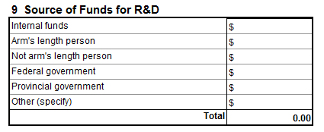
How do I fill it in? (cont’d)
Block 9 – Source of Funds for R&D
  Internal Funds – internal corporate funds of reporting patentee (does not include monies from parent or subsidiary companies if these are distinct corporate entities (see Not Arm’s Length).
  Arm’s Length – legal entity (individual or corporation) not related to patentee. If in doubt, refer to the Income Tax Act for definition.
  Not Arm’s Length – subsidiaries, parent companies, etc.
  Federal Government – include among others: monies obtained under an Appropriation Act for SR&ED, grants, subsidies, reimbursement of a forgivable loan (net of amount repaid to federal government during the year).
Notes:
Provincial Government – see federal.
Other: all monies received that do not fall into any of the above categories.

Slide 20
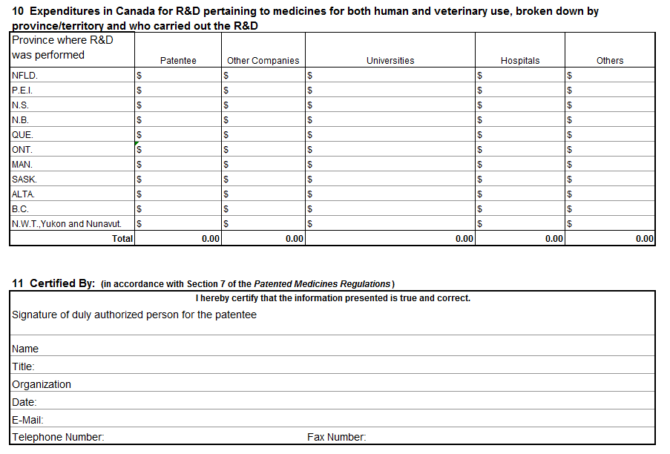
How do I fill it in? (cont’d)
Notes:
Pretty straight forward – Block 10 is the same definitions as Block 7.
Block 11 – signature of patentee or authorized company representative – the individual should have authority to bind the company and be knowledgeable about the information supplied.

Slide 21
Reconciling Expenditures
The most common mistake in Form 3 submission is the failure to reconcile certain Blocks:
Block 5 = Block 7 + Block 8 (total)
Block 5 = Block 10
Block 9 = Block 5 + Block 6 (equipment only)
Block 7 + Block 8 = Block 10 (for each column)

Slide 22
Frequently Asked Questions
When is the filing date?
March 1.
Do we get reminder about filing date?
Yes, the first reminder will be in January NEWSletter. The second reminder will be through an e-mail in mid-February.
What happens if I don’t file on time?
You will receive a written reminder and be given a further 7 days. If you fail to do so Board staff will request that the Board issue a Section 88 order requiring you to file the information. We will report this order in our publications and on our website.
What is a Board order, and how would I be given one?
See above.
Can I get an extension?
There is no flexibility on the March 1 date.
How do we determine Rx&D and non-Rx&D members
Based on December 31 member list on Rx&D web site
Who can sign?
Authorized company representative knowledgeable about the information on the form. Usually the CFO.

Slide 23
Patented Medicines Prices Review Board
New Foreign Price Source Policy
Tanya Potashnik, Director Policy & Economic Analysis Branch

Slide 24
Purpose
The PMPRB is constantly seeking ways to contribute to sustainable health care spending in Canada through a modern and progressive framework for regulating patented drug prices.
To this end, the PMPRB is pursuing implementation of a more transparent and predictable process by which Board Staff approve or reject price sources other than the Usual and Customary (U&C) price sources when the U&C sources are unavailable for international price verification.

Slide 25
Current Practice
The Patented Medicines Regulations require patentees to file publicly available ex-factory prices for all drugs that are sold in Canada by the patentee.
The Regulations also indicate that the notion of publicly available ex-factory price also includes any price that is agreed on by the patentee and the regulatory authority.
To ensure transparency, consistency and predictability, the PMPRB accepts price data filed by patentees by using a fixed list of Usual and Customary (U&C) public sources posted on the PMPRB website.

Slide 26
Challenges
These sources provide certain challenges:
  Not every source provides ex-factory prices
  Not every source provides a price for every drug sold in the corresponding comparator country
  Not every source is a national agency
This results in the PMPRB having to adapt by:
  Converting pharmacy retail prices (e.g. by Rote Liste) to ex-factory by “backing out” the price through regulated distribution margins.
  Validating non-U&C prices on a case-by-case basis when prices are not available from U&C sources and the patentee is able to provide documentary evidence as to why the new source should be accepted.
  However, European U&C sources have recently started providing more ex-factory prices, so less backing out is necessary than in past.
  Generally speaking, hospital prices are not available for Europe.
  PMPRB considers prices by customer class (wholesale, pharmacy, hospital, other).

Slide 27
Current U&C Public Sources
Country | U&C Public Source | Type of Price | Regulatory Body?
France | Vidal | Ex-factory Pharmacy | No
Germany | Rote Liste | Pharmacy Retail | No
Italy | L’informatore Farmaceutico | Pharmacy Retail | No
Sweden | Dental & Pharmaceutical Benefits Agency (TLV) | Ex-factory Pharmacy | Yes
Switzerland | Federal Office of Public Health (BAG) | Ex-factory Wholesale | Yes
UK | Monthly Index of Medical Specialties (MIMS) | Ex-factory Pharmacy | No
USA | Department of Veterans Affairs (VA) Red Book’s Wholesale Acquisition Cost (WAC) Red Book’s Direct Price (DP) | Ex-factory Wholesale Ex-factory Wholesale Ex-factory Hosp./Ex-factory Pharm. | Yes No No

Slide 28
Public sources for back-out formulas
No backing out necessary
Backing out required
Country | Public Source
France | VIDAL
Sweden | Dental & Pharmaceutical Benefits Agency (TLV)
Switzerland | Federal Office of Public Health (BAG)
UK | MIMS
USA | VA, Red Book
Country | Public Source
Germany | Rote Liste
Italy | L’Informatore Farmaceutico

Slide 29
Moving forward
The PMPRB is exploring adopting another U&C public source for Germany – Lauer-Taxe.
For other countries, there is no change to PMPRB policy of using U&C public sources for price verification.
However, PMPRB is publishing on online Decision Tree to provide transparency to patentees as to how PMPRB makes decisions about the acceptability of alternative sources if (and only if) U&C public sources are NOT available.

Slide 30
YES
Accepted
YES
Is it publicly available?
Case by case
Agreed upon with Regulatory Authority?
NO
NO
YES
Rejected
YES
Accepted
Is this an ex-factory price?
YES
Does it have regulated margins?
NO
NO
Rejected
Is it publicly available?
YES
Case by case
Agreed upon with Regulatory Authority?
NO
NO
Rejected

Slide 31
Examples
A patentee is unable to provide an Italian price from L’informatore Farmaceutico (no price is listed). The patentee submits a price from Gazzetta Ufficiale della Repubblica Italiana.
  Is it an ex-factory price? YES ➔
  Is it publicly available? YES ➔
  ACCEPTED.
A patentee files prices based on an internal database, which may or may not reflect the results of actual sales.
  Is it an ex-factory price? YES ➔
  Is it publicly available? NO ➔
  Is it agreed upon by the national regulatory authority? NO ➔
  REJECTED.

Slide 32
Conclusion
The PMPRB is constantly seeking ways to contribute to sustainable health care spending in Canada through a modern and progressive framework for regulating patented drug prices.
Thank you for the opportunity to share our most recent efforts to increase the transparency of predictability of our regulatory process.

Slide 33
Verification of International Prices for New Medicines
A verification of international prices starting with all new medicines with introductory periods in 2014(2).
Advisory assistance will be given for non-customary international sources by the Policy and Economic Analysis branch

Slide 34

Scientific Review:
Company Scientific Submissions
Please do not include pricing data in company scientific submissions to go to the Human Drug Advisory Panel
If pricing data is included, Board Staff will return the submission and ask for it to be re-filed without prices
The company will risk not making the deadline for the submission!

Slide 35
Patented Medicines Prices Review Board
Online Filing Tool
Montreal: John Cook, Senior Regulatory Officer
Toronto: Kirk Stanley, Senior Regulatory Officer

Slide 36
Online Filing
July to December 2014 period only
Template will be sent out 45 days before the filing deadline
The period (2014-2) will be pre-filled in the template
Only period available when using the filing tool will be 2014-2
Are you a new user? Email the Compliance account advising us you are a new user
Do you require additional user? Email the Compliance account in early January to create additional user names for your company

Slide 37

Best Practice: Filing
An analysis is only as good
as the data on which it is based!

Slide 38
Checklist for Filing a Form 2 Successfully
3 separate files (not worksheets): Block 1,2,3 - Block 4 - Block 5
Files in Excel format
Most recent Block 1,2,3 from PMPRB website is used
Most recent Block 4 and 5 templates sent by PMPRB Staff are used
Block 2 is blank in a semi-annual filing
Block 2 includes drug names when reporting a first day sale
Block 3 is signed in Excel– If not signed in Excel, send two Block 1,2,3 one not signed in Excel and one signed in PDF
Block 4 and 5: DINs, strength/unit, dosage form and generic names are reported as on the templates
Block 4 and 5: Absolutely no combination - zero revenues with zero Number of Packages Sold - to indicate no sales. Please write it in e-mail accompanying Form 2.
Completed Form 2 is uploaded via new PMPRB Online Filing Tool.

Slide 39
What Must be Emailed into the Compliance Inbox?
Form 1s (original and amended)
Product monographs and draft product monographs
Form 2 amendments
Form 2s for previous period filing (anything before 2014-2)
Section 82 (notification of intent to sell, first day of sales)
Form 3s

Slide 40
Patented Medicine Prices Review Board
Regulatory Amendments 2015
Tanya Potashnik, Director of Policy and Economic Analysis

Slide 41
Objectives and Outline
To inform stakeholders of the progress made to date on proposed amendments to the Patented Medicines Regulations to decrease the frequency of filing requirements.
To solicit stakeholder feedback on the proposed amendments and respond to questions.

Slide 42
Context for the Proposed Amendments
In the spirit of the Government’s Red Tape Reduction Plan and Economic Action Plan, the PMPRB has committed to examining its price review process to identify ways to reduce the regulatory burden on patentees and increase efficiency without adversely affecting its mandate to protect consumers.
The Board consulted stakeholders in a Notice and Comment issued May 2013 on two priority initiatives to amend the CPI-Adjustment Methodology (completed) and decreasing the frequency of filing requirements of patentees (on-going).
12 stakeholders provided submissions.
Feedback on both proposals was generally supportive.

Slide 43
Proposed Regulatory Amendments
Eliminate the requirement on patentees to provide a Form 2 to the PMPRB for new patented medicines within 30 days of first sale and, for existing patented medicines, semi-annually.
Minor amendment to Form 1 to require patentees to include publicly available ex-factory price in Canada on the date of first sale.

Slide 44
Question #1:
How would these changes affect reporting and pricing ceiling calculations for new patented medicines?
For new patented medicines, Form 2 will no longer be required within 30 days of the first day of sales.
  Example: Date of first sale (Mar 1, 2015).
  For 2015, submit Form 2 for Mar 1 to June 30 period, July 1-December 30 period.
  For 2016, submit Form 2 for Jan 1-Dec 30 period.
In terms of ceiling prices for new patented medicines, introductory benchmark prices and price tests are not affected (these methodologies are treated in the Guidelines and are not affected by changes to the Regulations).

Slide 45
Question #2:
Would eliminating the semi-annual filing of Form 2 cause patentees to have less warning of potential instances of excessive pricing?
The PMPRB has studied the potential impact of the proposed regulatory amendment on the lead time available to patentees.
From 2007 to 2011, the information from semi-annual reporting could only have provided patentees with effective warning of potential excessive pricing for <1% of patented medicines.
Nonetheless, the PMPRB will address this issue by providing patentees with an early warning tool in the Compliance Status Report (sent following review of previous year’s data).

Slide 46
Steps in the Regulatory Development Process
A.) Pre-Publication
Triage to determine the level of impact of the regulatory proposal
Regulatory Impact Analysis Statement (RIAS)
Regulation drafting
Ministerial approval of regulatory package
Regulatory package to be sent to Privy Council Office
Treasury Board considers submission & whether to approve for pre-publication
Pre-publish proposed regulation in Canada Gazette Part I (30 days to comment)

Slide 47
Steps in the Regulatory Development Process
B.) Final Approval, Publication, and Registration
Review comments on draft regulation, revise, update RIAS as needed
Department of Justice examines proposed regulation and RIAS
Ministerial approval of regulatory package
Final regulatory submission to Privy Council Office
GIC (Treasury Board ministers advising the Governor General) considers the submission and decides whether to make the regulation
Register and publish regulations in Canada Gazette, Part II
Review by the Standing Joint Committee for the Scrutiny of Regulations

Slide 48
Next Steps
Proposed regulatory amendment package is currently at the Minister’s Office (Health Canada)
Once it is signed by the Minister, it will be sent over to the Privy Council’s Office so that it can be approved at the next available Treasury Board meeting
Targeted date of Ministerial sign-off: Early January 2015
Targeting the first Treasury Board meeting of 2015: late January 2015.
Once Treasury Board approves the proposed regulatory amendment package, it can be submitted for Pre-publication in Canada Gazette, Part I.

Slide 49
Next Steps
Targeting pre-publication of proposed regulatory amendments in Canada Gazette, Part I in February 2015
30 day comment period
Following publication, the Board will invite comments from stakeholders by posting the proposed Regulations on its website and notifying its e-subscribers accordingly and publishing an article in the NEWSletter
Targeting final approval of proposed regulation and registration and publication of proposed regulations in Canada Gazette, Part II for Fall, 2015
Targeting implementation of proposed regulation for 2016

Slide 50
Proposed Regulatory Amendments
Questions?
Comments?

Slide 51
Patented Medicine Prices Review Board
Interpretation Policy
Jeff Biggs, Manager, Policy Development

Slide 52
Objectives and Outline
To inform stakeholders of the government-wide Interpretation Policy requirements.
To present the PMPRB Interpretation Policy to stakeholders and to solicit feedback on areas of improvement.

Slide 53
Context
As part of the Red Tape Reduction Action Plan, the Government of Canada committed to making it easier to do business with regulators by requiring Interpretation Policies that clarify, up front, how regulators interpret questions about meeting regulatory requirements.
These policies are being put it place to make the means by which regulators communicate with regulated industries more transparent to all Canadians.
Every department and agency will produce and publish an Interpretation Policy, including conditions under which the department or agency will provide written advice to stakeholders, by December 19, 2014.

Slide 54
Interpretation Policy – At a Glance
Each Interpretation Policy must include statements that fulfill the following elements:
Predictability
Service
Stakeholder Engagement
Improvement

Slide 55
Predictability Requirements
Define conditions under which written interpretations will be provided to regulated parties;
Commitment to Plain Language;
Internal practices and tools to improve the quality and consistency of answers given by officials;
FAQs for 10 most accessed regulations and for new regulations with an impact on business and commitment to develop FAQs for recurring queries;
Commitment to timeliness in responding to stakeholder inquiries.

Slide 56
PMPRB Commitment to Predictability
Commitment to plain language outlined in the Report on Plans and Priorities, Departmental Performance Report, and in the Management Response and Action Plan published in response to the 2012 Program Evaluation of the PMPRB.
Frequently Asked Questions (FAQs) for the Patented Medicines Regulations and all newly generated regulations are available on the Acts and Regulations web page.
Regular communication with stakeholders through a variety of means including regular “outreach sessions” with stakeholders to provide guidance and advice.
Guidance documents and other relevant information can be accessed on the PMPRB’s website. Information related to the Rules of Practice and Procedure for Hearings, the Compendium of Policies, Guidelines and Procedures (Guidelines), outreach sessions materials and the Patentee’s Guide to Reporting also available on the PMPRB website.
Commitment to updating FAQs in response to recurring inquiries. Commitment to acknowledging inquiries within 48 hours of receipt or answering inquiries within 5 working days of receipt. *
* Note: Time commitment associated with completion of scientific and price tests is outlined in PMPRB Service Standards.

Slide 57
Service Requirements
  Commitment to service professionalism;
  Identify practices and tools to track complaints regarding regulatory guidance;
  Ensure officials have necessary skills and technical knowledge to provide quality service and accurate regulatory guidance.

Slide 58
PMPRB Commitment to Service
Service Commitment
The PMPRB is committed to excellence in service to all stakeholders by providing courteous and respectful responses to stakeholder inquiries. The PMPRB’s website includes three Service Standards describing the timelines associated with the PMPRB’s completion of scientific and price reviews for patented medicines.
Service Accountability
The PMPRB will address concerns raised by stakeholders related to their understanding of regulatory requirements through existing feedback mechanisms, such as those described in the Service Standards. Also, regular outreach sessions serve to improve communication between stakeholders and the PMPRB, as well as to promote openness and transparency in the regulatory process.
Staff Training
The PMPRB makes every effort to ensure that staff have the necessary skills and technical knowledge to provide quality service and accurate guidance. Training sessions are provided to regulatory staff to ensure that consistent advice is given to patentees. One regulatory officer is assigned to each patentee and is responsible for answering all questions related to that patentee’s regulatory compliance obligations.

Slide 59
Stakeholder Engagement Requirements
  Commitment to engage stakeholders when developing guidance on regulatory compliance and answering questions;
  Identify practices and tools to engage stakeholders in the development of regulatory guidance.

Slide 60
PMPRB Engagement Commitment
Commitment to Stakeholder Engagement
The PMPRB is committed to engaging with its stakeholders as appropriate when developing, reviewing and/or refining practices and materials for providing information and guidance on regulatory compliance and answering questions, as appropriate.
Stakeholder Engagement Mechanisms
The Guidelines provide direction to patentees on how to comply with relevant provisions of the Patent Act and the Patented Medicines Regulations. The PMPRB is required by the Patent Act to consult stakeholders before issuing any new Guidelines. The PMPRB’s Consultation Policy outlines its approach to stakeholder engagement. Clarifications to the Guidelines are communicated through the quarterly NEWSletter. Stakeholders are consulted on proposed amendments to the Guidelines through a written Notice and Comment process. An updated version of the Guidelines, reflecting changes and clarifications, is released annually in June.
The PMPRB also engages stakeholders through multiple mechanisms including: bilateral meetings; conferences; formal consultations; working groups, newsletters; webinars; the PMPRB Twitter account, and by providing opportunities for feedback through a proactive Internet presence. For example, consultation opportunities may be found on Forward Regulatory Plan-Acts and Regulations-PMPRB.

Slide 61
Improvement Requirements
  Check in with stakeholders in 2014-15 on current interpretation practices;
  By March 31, 2015, identify areas of improvement and metrics for evaluating their implementation;
  Implement these improvements over 2 years and provide performance update by March 31, 2017.

Slide 62
PMPRB Improvement Commitment
The PMPRB will monitor the implementation of this policy by soliciting feedback from stakeholders through the written Notice and Comment process after informing stakeholders of the policy through the quarterly NEWSletter and also by consulting with stakeholders during outreach sessions in 2014-2015. Based on the resulting feedback, the PMPRB will identify areas of improvement and metrics for evaluating their implementation by March 31, 2015.
The PMPRB will implement these improvements over two years and then issue a status report on its website by March 31, 2017.

Slide 63
Feedback from Stakeholders
Where do you think PMPRB can improve its interpretation services?
Examples:
Providing stakeholders access to various approaches and tools to build awareness and understanding of regulatory requirements (e.g. guidance materials, FAQs, etc.);
Providing professional and timely service;
Providing clear and consistent responses to regulatory questions;
Providing stakeholder engagement opportunities;
Other (Please specify).

Slide 64
Queries to Board Staff?
  Guidelines: Ginette Tognet
  Tel: (613) 954-8297 Email: ginette.tognet@pmprb-cepmb.gc.ca
  Scientific Review: George Botulynsky
    Tel: (613) 960-4575 Email: george.botulynsky@pmprb-cepmb.gc.ca
  Introductory Price Review: Jarrett Todd
  Tel: (613) 957-8712 Email: jarrett.todd@pmprb-cepmb.gc.ca
  Filing Form 1 and 2: Christina Conlin
  Tel: (613) 948-9219 Email: christina.conlin@pmprb-cepmb.gc.ca
  Investigation: Senior Regulatory Officer assigned to your company
  PMPRB 101 (1 on 1 Guideline Training): Theresa Morrison
  Tel: (613) 954-8298 Email: theresa.morrison@pmprb-cepmb.gc.ca
  Form 3: Lokanadha Cheruvu
  Tel: (613) 954-9812 Email: lokanadha.cheruvu@pmprb-cepmb.gc.ca

