Slide 1
Patented Medicine Prices Review Board
Outreach Sessions 2014
Montreal - June 11, 2014
Toronto - June 12, 2014

Slide 2
Overview
Introduction
Filing process for January to June 2014
Online filing tool
  Background
  Demonstration
Best Practice: Filing
  Filing “no sales”
  Preparing for on-line filing
Possible errors and error reports

Slide 3
Filing process for January to June 2014
Templates for the January to June 2014 filing period to be sent from June 11 to 13, 2014.
Email from Compliance account – June 16 and 17, 2014
  Username
  Instructions for setting your password
Patentees to enter new password
Online tool will be made available on the PMPRB website on Monday June 23rd
  Access online tool via “Are you a Patentee?”

Slide 4
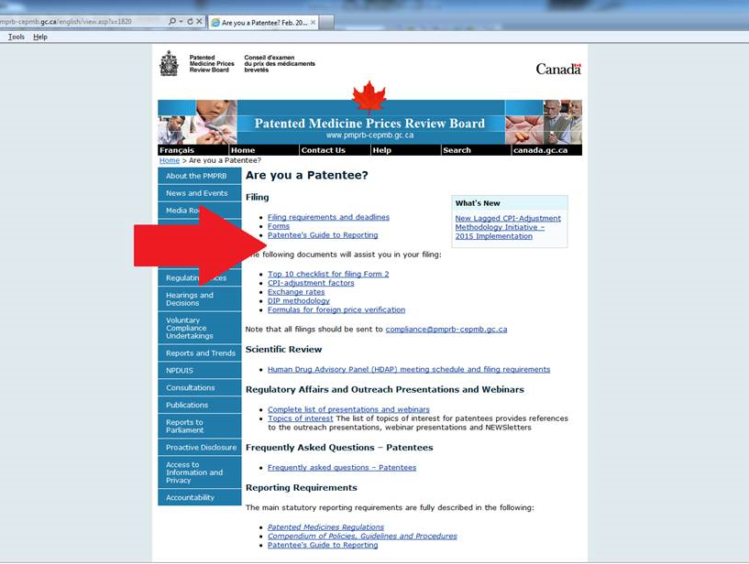

Slide 5
Online Filing Tool
Rejuvenation (Background)
Why Redevelop/upgrade (Benefits)
What’s Next?
Online Filing
Let’s see how it works !

Slide 6
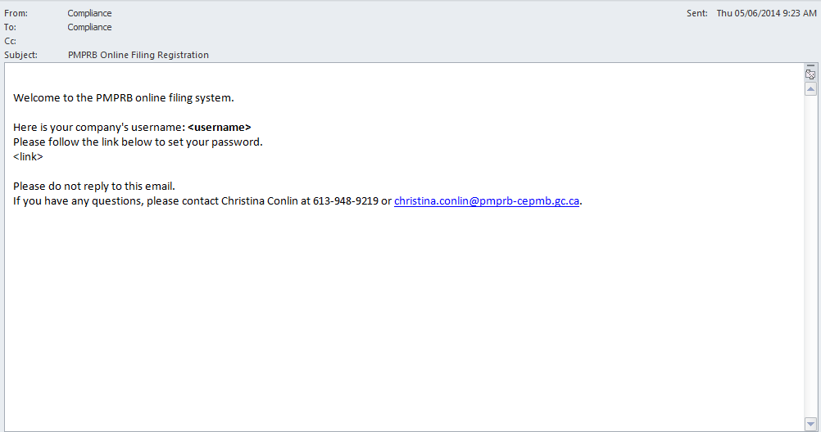

Slide 7
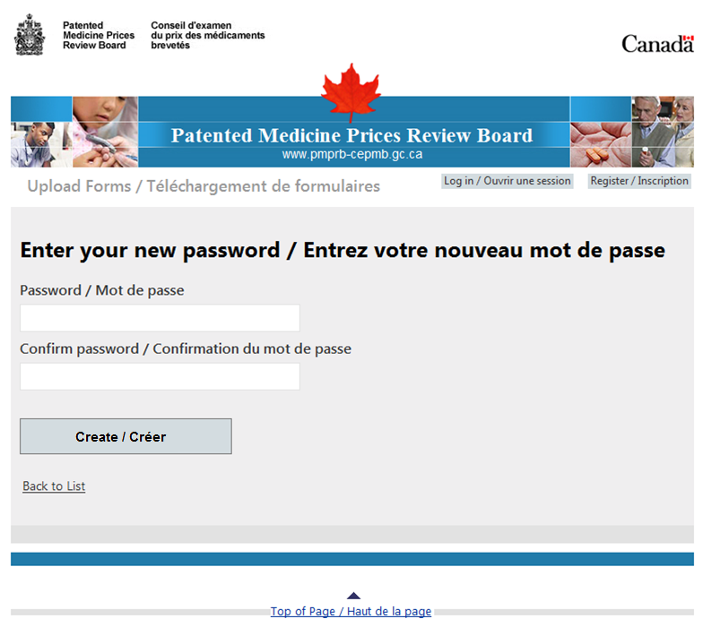

Slide 8
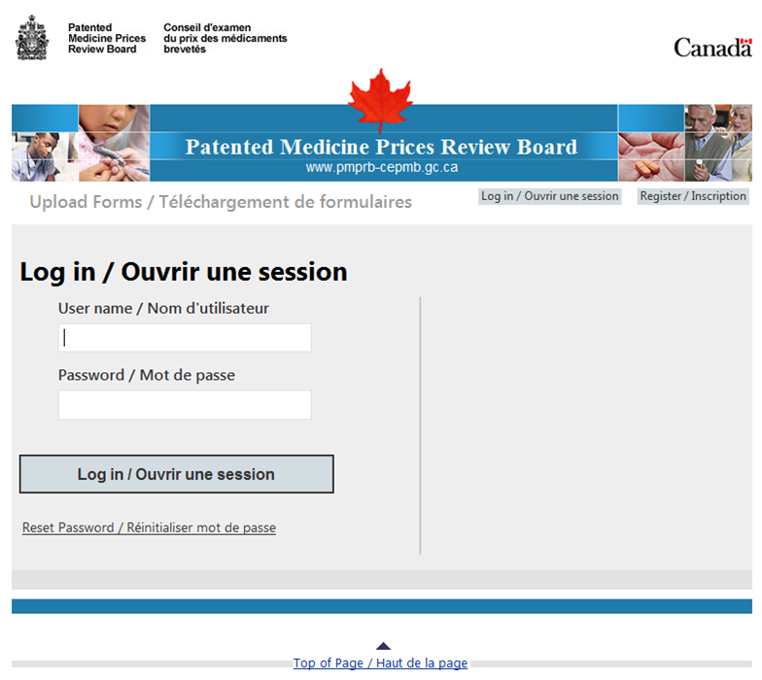

Slide 9
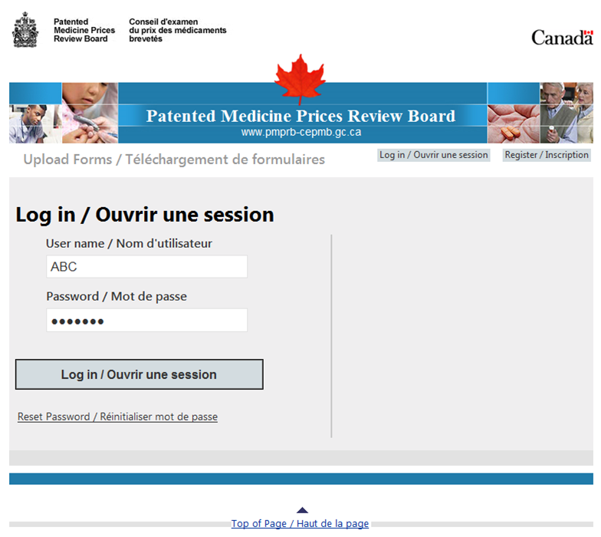

Slide 10
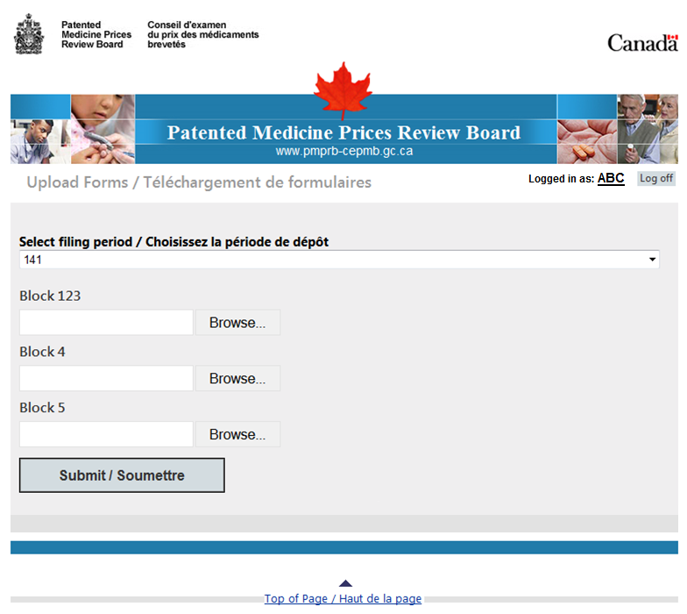
ABC!

Slide 11
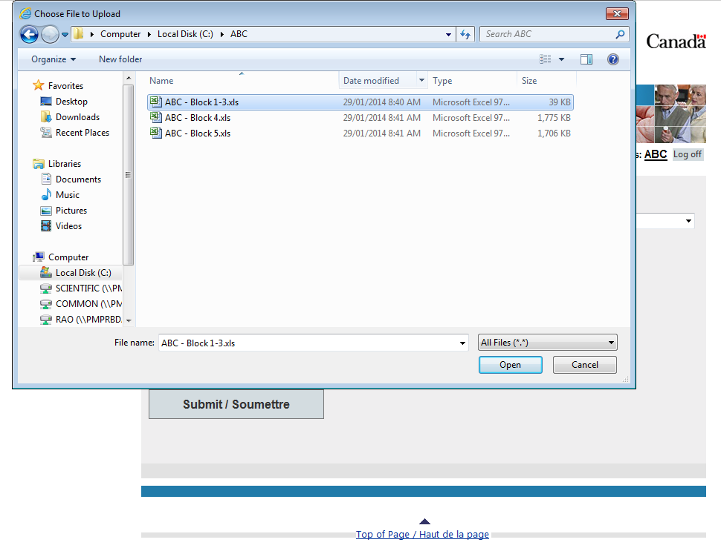
ABC!

Slide 12
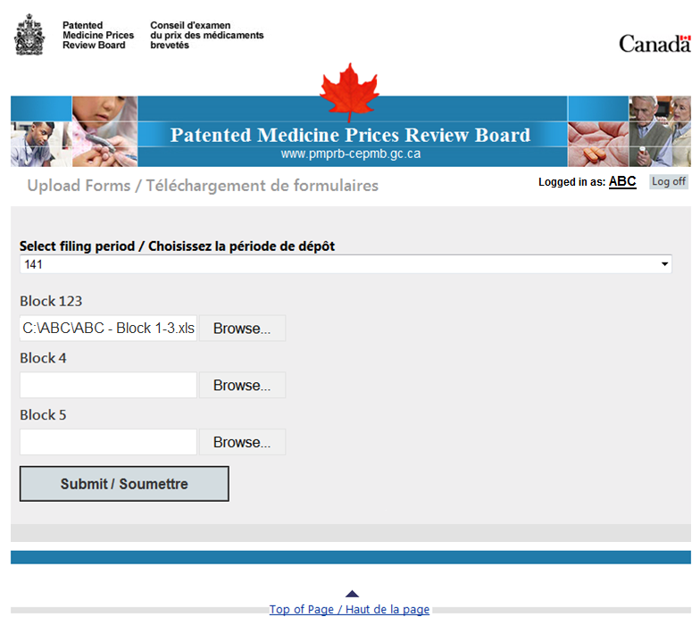
ABC!

Slide 13
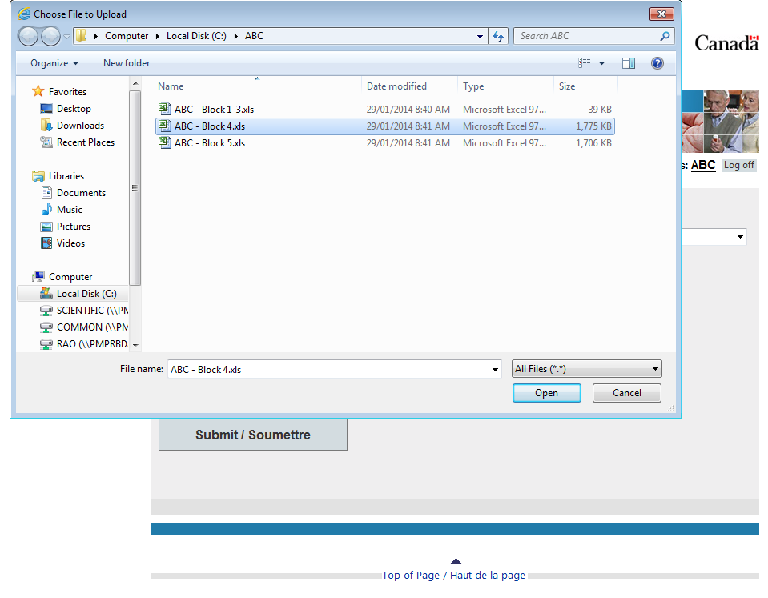
ABC!

Slide 14
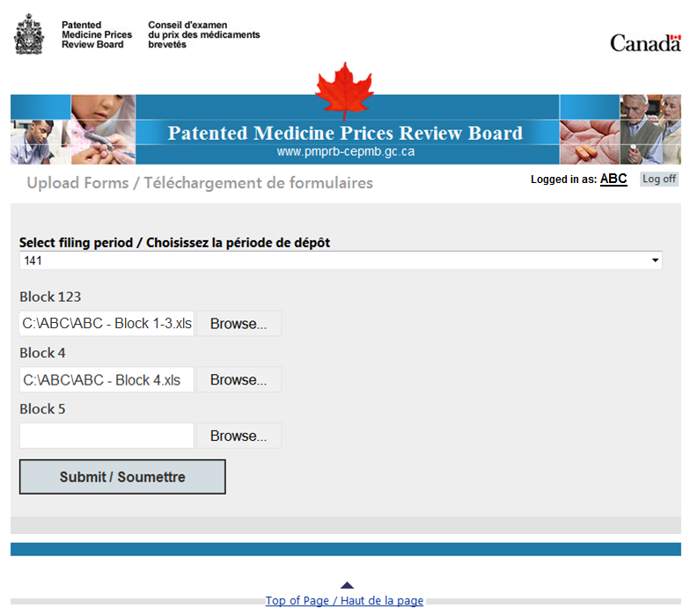
ABC!

Slide 15
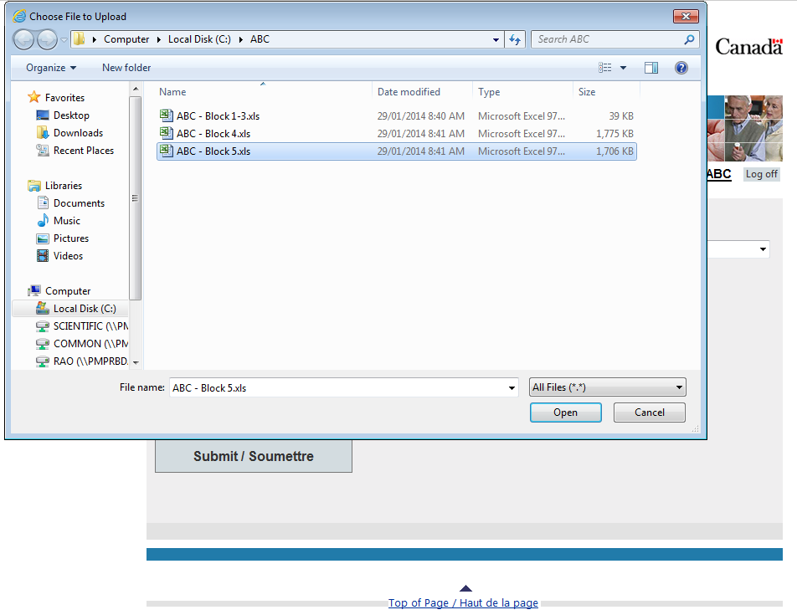
ABC!

Slide 16

ABC!

Slide 17


Slide 18
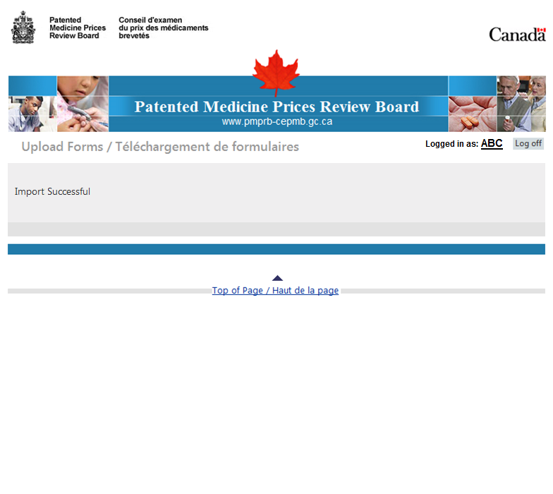

Slide 19
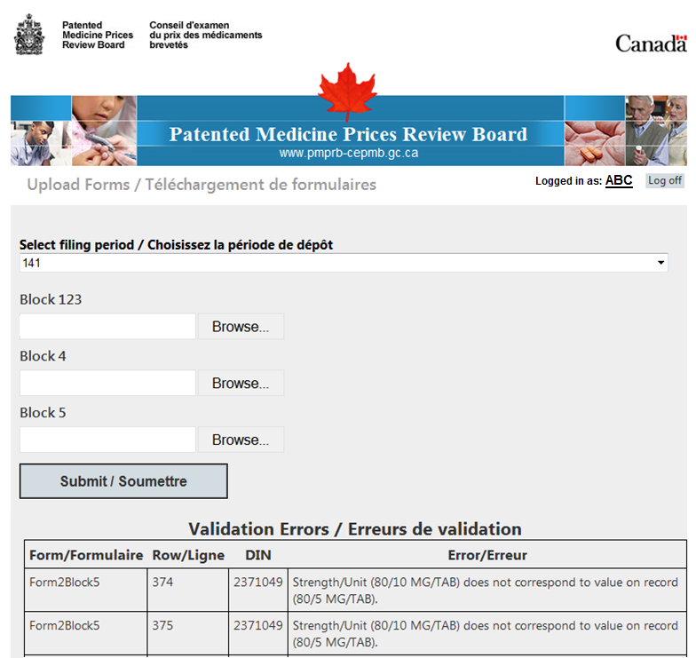

Slide 20
Form 2, Block 1, 2, 3
Signature in the Excel version
  Block 1, 2, 3 sent via Online filing tool
No signature in the Excel version
  Block 1, 2, 3 sent via Online Filing Tool – Excel version with no signature
  PDF copy of signed Block 1, 2, 3 sent to
    compliance@pmprb-cepmb.gc.ca

Slide 21
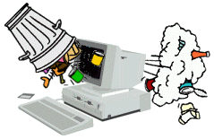
Best Practice: Filing
An analysis is only as good
as the data on which it is based

Slide 22
Filing “no sales”
When none of a patentee’s drug products under the jurisdiction of the PMPRB are sold during a reporting period:
  Send an e-mail to compliance@pmprb-cepmb.gc.ca to inform Board Staff that there were no sales during the reporting period
  No sales = no Form 2 needed

Slide 23
Filing “no sales”
When a drug product is not sold (no transactions) during a reporting period:
  After Form 2 filed using Online Filing Tool, send an email to compliance@pmprb-cepmb.gc.ca and indicate which DIN is not reported for the period and provide an explanation, e.g., no sales, patent expired or lapsed
  Delete the line(s) for this drug product in the Form 2 Block 4 and Block 5 templates for the reporting period
  If the product is not sold, do not enter 0 in “number of packages sold” and “net revenues” columns as 0 is a value in the PMPRB electronic system. This is true at the DIN level, market level, province/country level, on Block 4 and Block 5.

Slide 24
Preparing for on-line filing

Slide 25

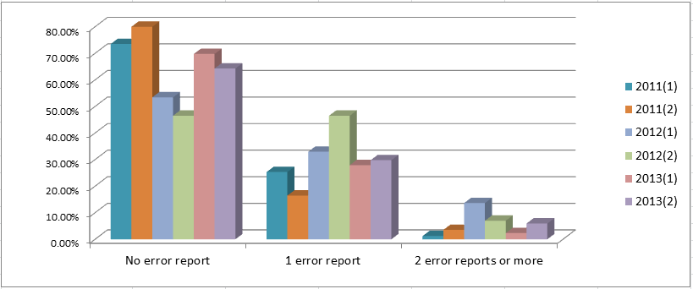
Semi-Annual Regulatory Filing: Error Reports

Slide 26
Checklist for filing a Form 2 successfully
3 separate files (not worksheets): Block 1,2,3 - Block 4 - Block 5
Files in Excel format
Most recent Block 1,2,3 from PMPRB website is used
Most recent Block 4 and 5 templates sent by PMPRB Staff are used
Block 2 is blank in a semi-annual filing
Block 2 includes drug names when reporting a first day sale
Block 3 is signed in Excel– If not signed in Excel, send two Block 1,2,3 one not signed in Excel and one signed in PDF
Block 4 and 5: DINs, strength/unit, dosage form and generic names are reported as on the templates
Block 4 and 5: Absolutely no combination - zero Revenues with zero Number of Packages Sold - to indicate no sales. Please write it in e-mail accompanying sending of Form 2.
Completed Form 2 is uploaded via new PMPRB Online Filing Tool

Slide 27
Online Filing Tool - Error Messages
Error Message | Description
At least one field from Net Revenue or Average Package Price must contain a valid value. | Please enter at least one field from Net Revenue or Average Package Price.
At least one field from Net Revenue or Packages Sold must contain a value greater than 0. | Please enter at least one field from Net Revenue or Packages Sold with a value greater than 0.
Customer Class ({0}) is not recognized. | Please enter a valid customer class.
Customer Class code ({0}) is not recognized. | Please enter a valid customer class code.
DIN ({0}) does not have a date of first sale and/or introductory period recorded in the system. | Please send a Form 1 with a date of first sale to compliance@pmprb-cepmb.gc.ca before submitting data for this DIN.
DIN ({0}) has been archived in the system. | If this drug has valid patents, please send a Form 1 with the new patent information to compliance@pmprb-cepmb.gc.ca before submitting data for this DIN. If there are no valid patents, please remove this drug from your submission.
DIN ({0}) is not recognized. | Please enter a valid DIN.
Dosage ({0}) does not correspond to value on record ({1}). | Please enter the dosage form code as shown on the template.
Dosage Form ({0}) is not recognized. | Please enter the dosage form code as shown on the template.
Drug Individual Unit ({0}) is not recognized. | Please enter the strength/unit as shown on the template.
One check box from Original or Amendment must contain a valid value. | Please mark whether this submission is an Original or Amendment.
One or more of the files being submitted is not in the appropriate format (.xls or .xlsx). Please submit all files in the correct format. | Please submit the file using a valid Excel format.
Only one check box from Original or Amendment can contain a valid value. | Please check whether this submission is an Original or Amendment.
Pack Unit ({0}) is not recognized. | Please enter the strength/unit as shown on the template.
Region ({0}) is not recognized. | Please enter a valid region code.

Slide 28
Error message | Description
Strength/Unit ({0}) does not correspond to value on record ({1}). | Please enter the strength/unit as shown on the template.
The average package price must be greater than zero. If this drug product is not sold in this country, please remove the country row from the Block 5. | Please enter an average package price greater than zero. If this drug product is not sold in this country, please remove the country row from the Block 5.
The country is not present in the database. | Please enter a valid country code.
The DIN is not present in the database. | Please ensure the DIN is correct and that a Form 1 for this product has been submitted to compliance@pmprb-cepmb.gc.ca before submitting data for this DIN.
The DIN must have a value. | Please enter a valid DIN.
The dosage form is not present in the database. | Please enter the dosage form code as shown on the template.
The generic drug name is not present in the database. | Please enter the generic name as shown on the template.
The package size must be greater than 0. | Please enter a valid package size.
The period From Date is not a valid date. | Please enter a valid From date.
The period From must be less than the Period To Date. | Please ensure that the To date is greater than the From date.
The period To Date is not a valid date. | Please enter a valid To date.
The province is not present in the database. | Please enter a valid province code.
The specified dosage form is not matching the dosage form submitted in Form 1. | Please enter the dosage form code as shown on the template.
The strength/unit is not present in the database. | Please enter the strength/unit as shown on the template.

Slide 29
Online Filing Help
For all questions relating to:
  Templates
  Registration for Online Filing Tool
  Online Filing Tool
  Understanding Error Reports
  Christina Conlin
  Tel: (613) 948-9218
  E-mail: christina.conlin@pmprb-cepmb.gc.ca
  Hours: Monday to Friday 8:00 AM to 4:00 PM

